Slide 1
Welcome Safety Team
June 16, 2023

Slide 2
Introductions
My name is Kali (Kay-lee)
My pronouns are she/her
I am the safety coordinator
I love nature, reading, dancing, sculpting, playing with my family, fostering animals, science fiction, meditation, travel
Why do I work safely?

Slide 3
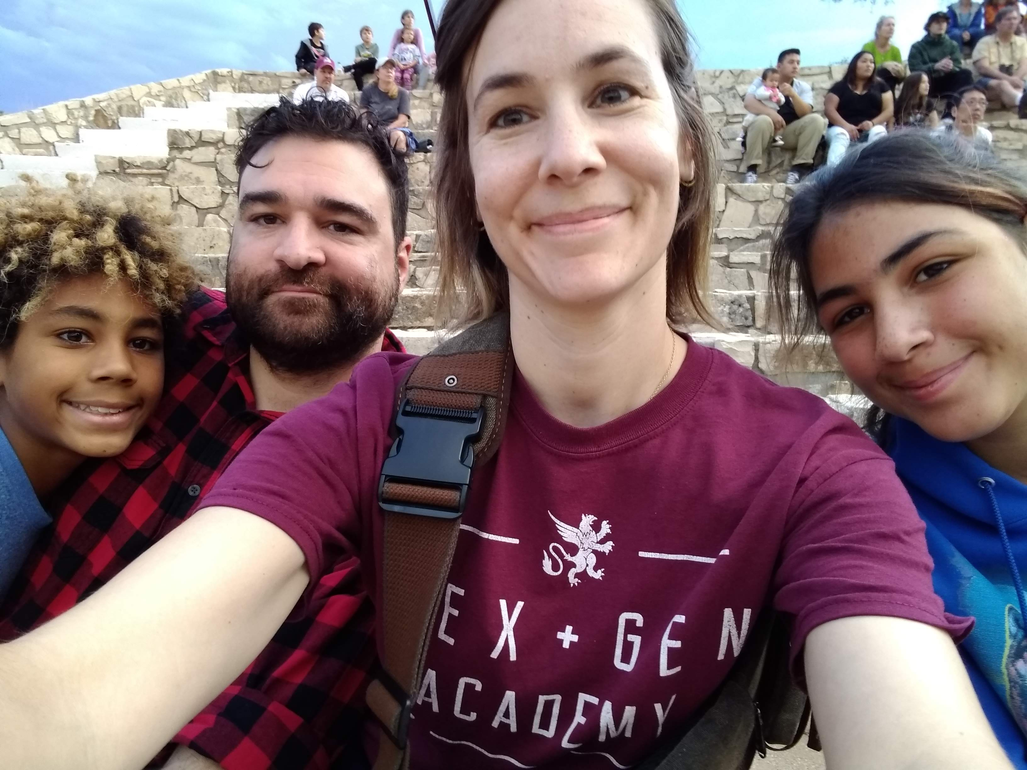
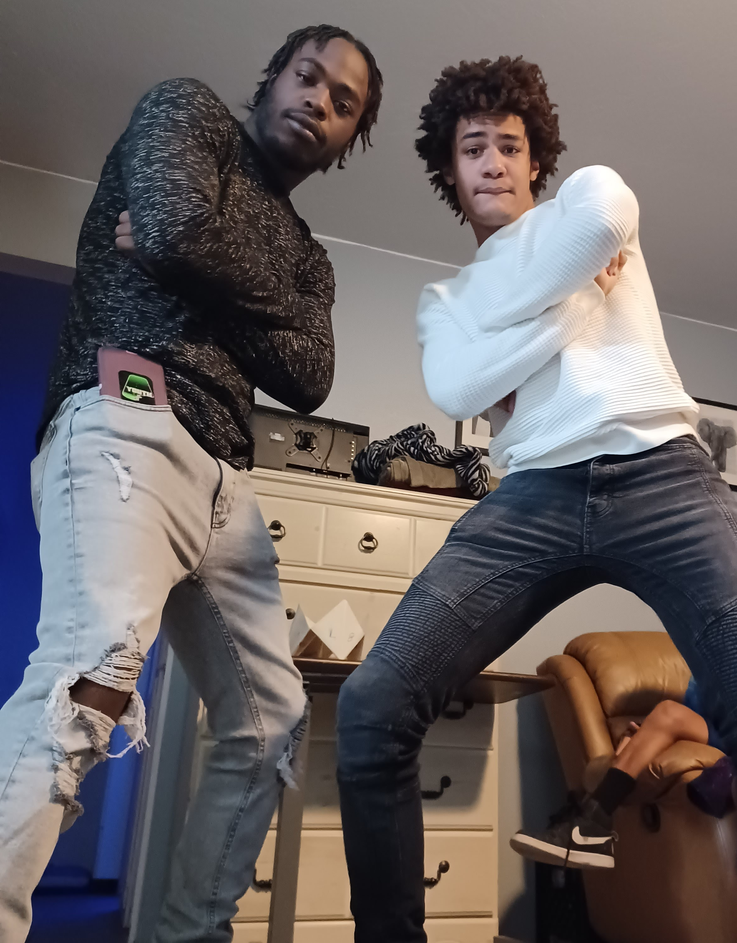
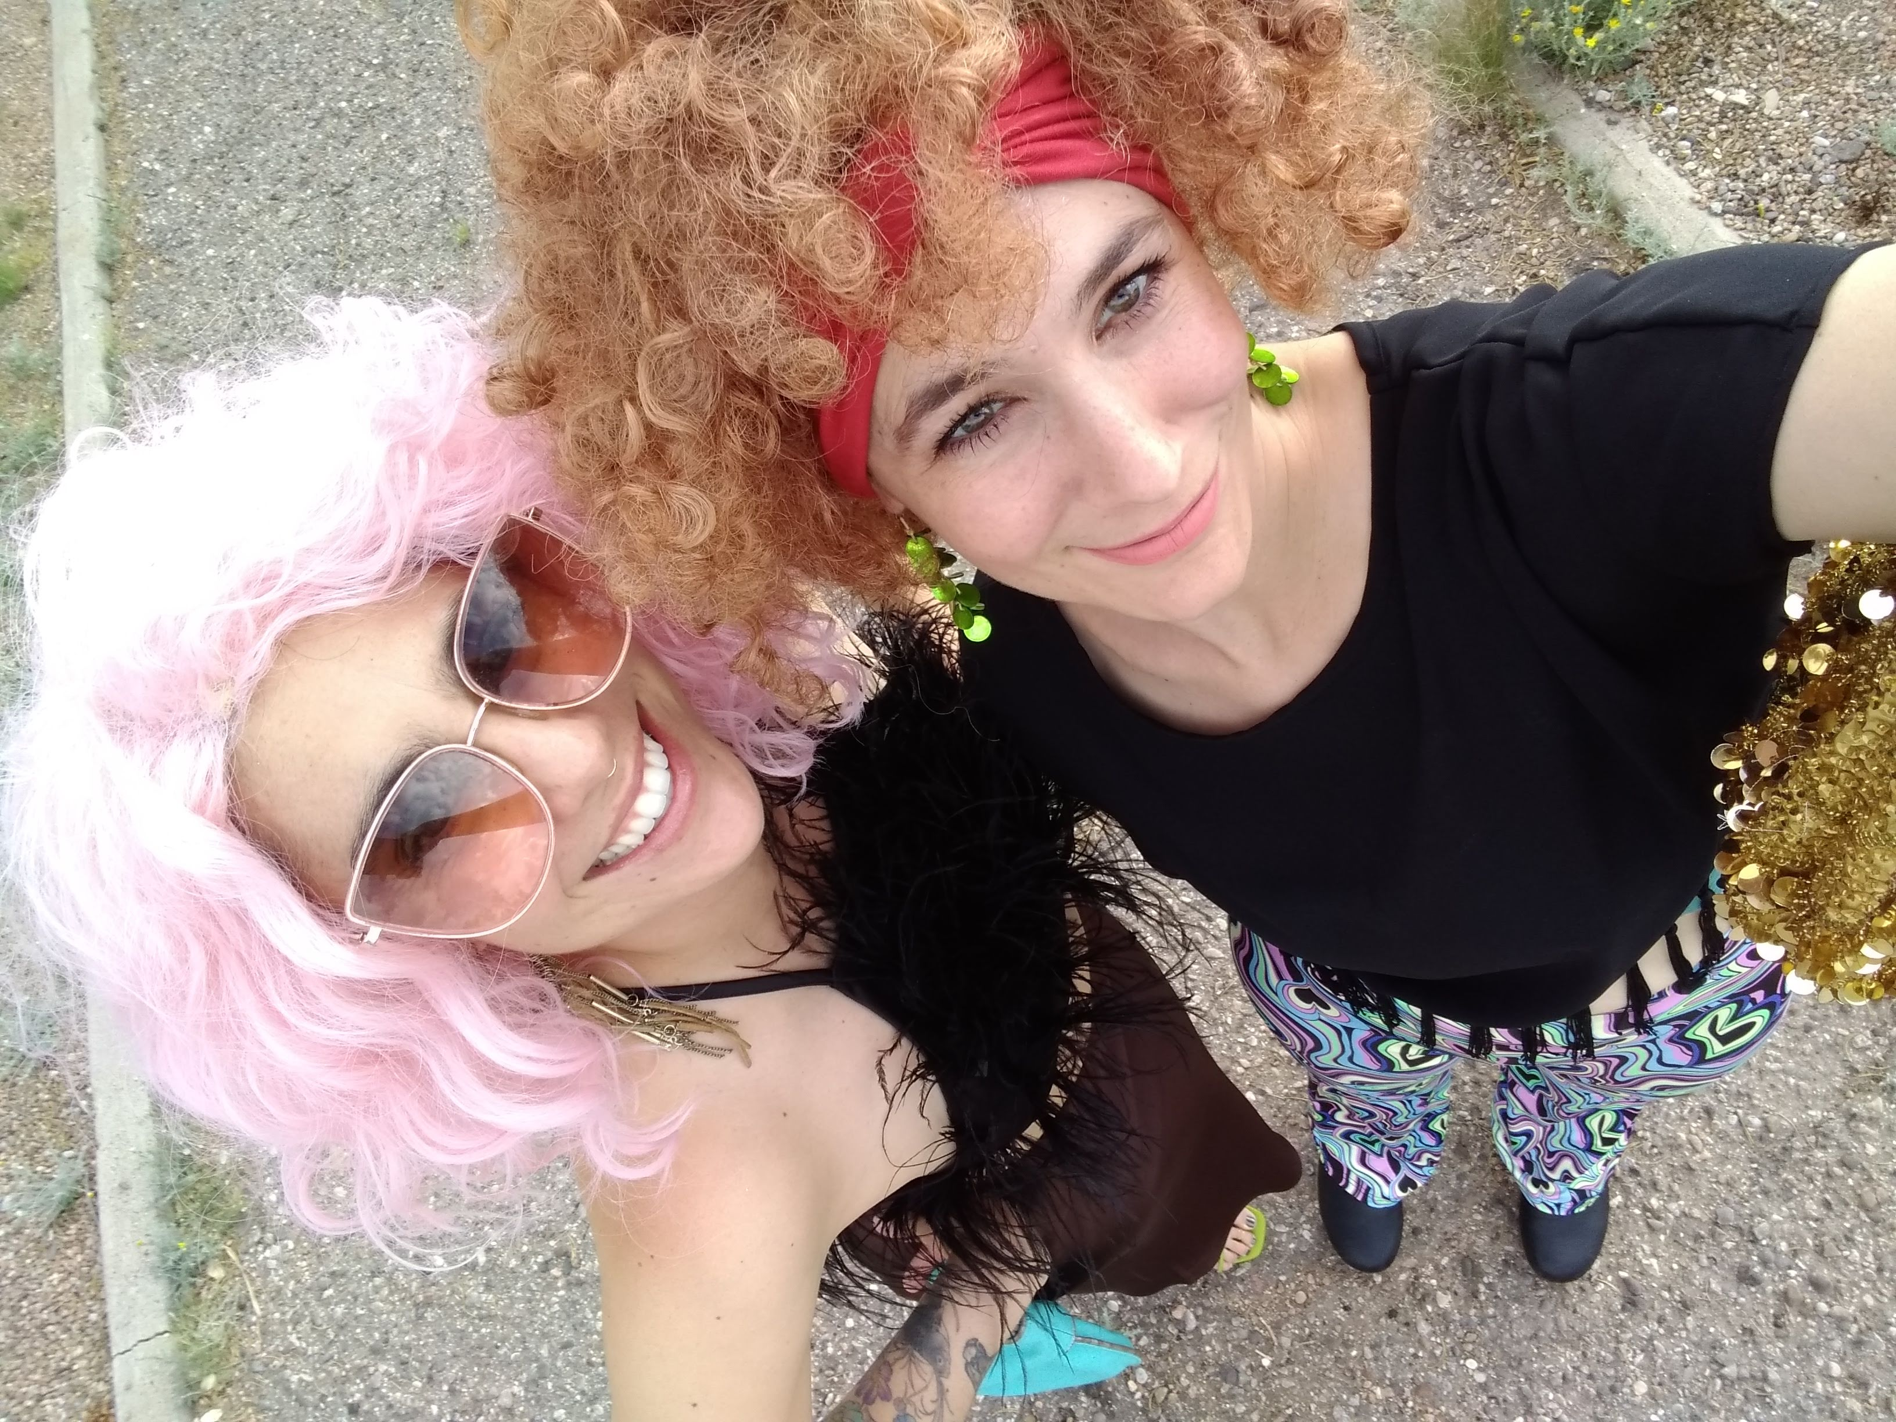
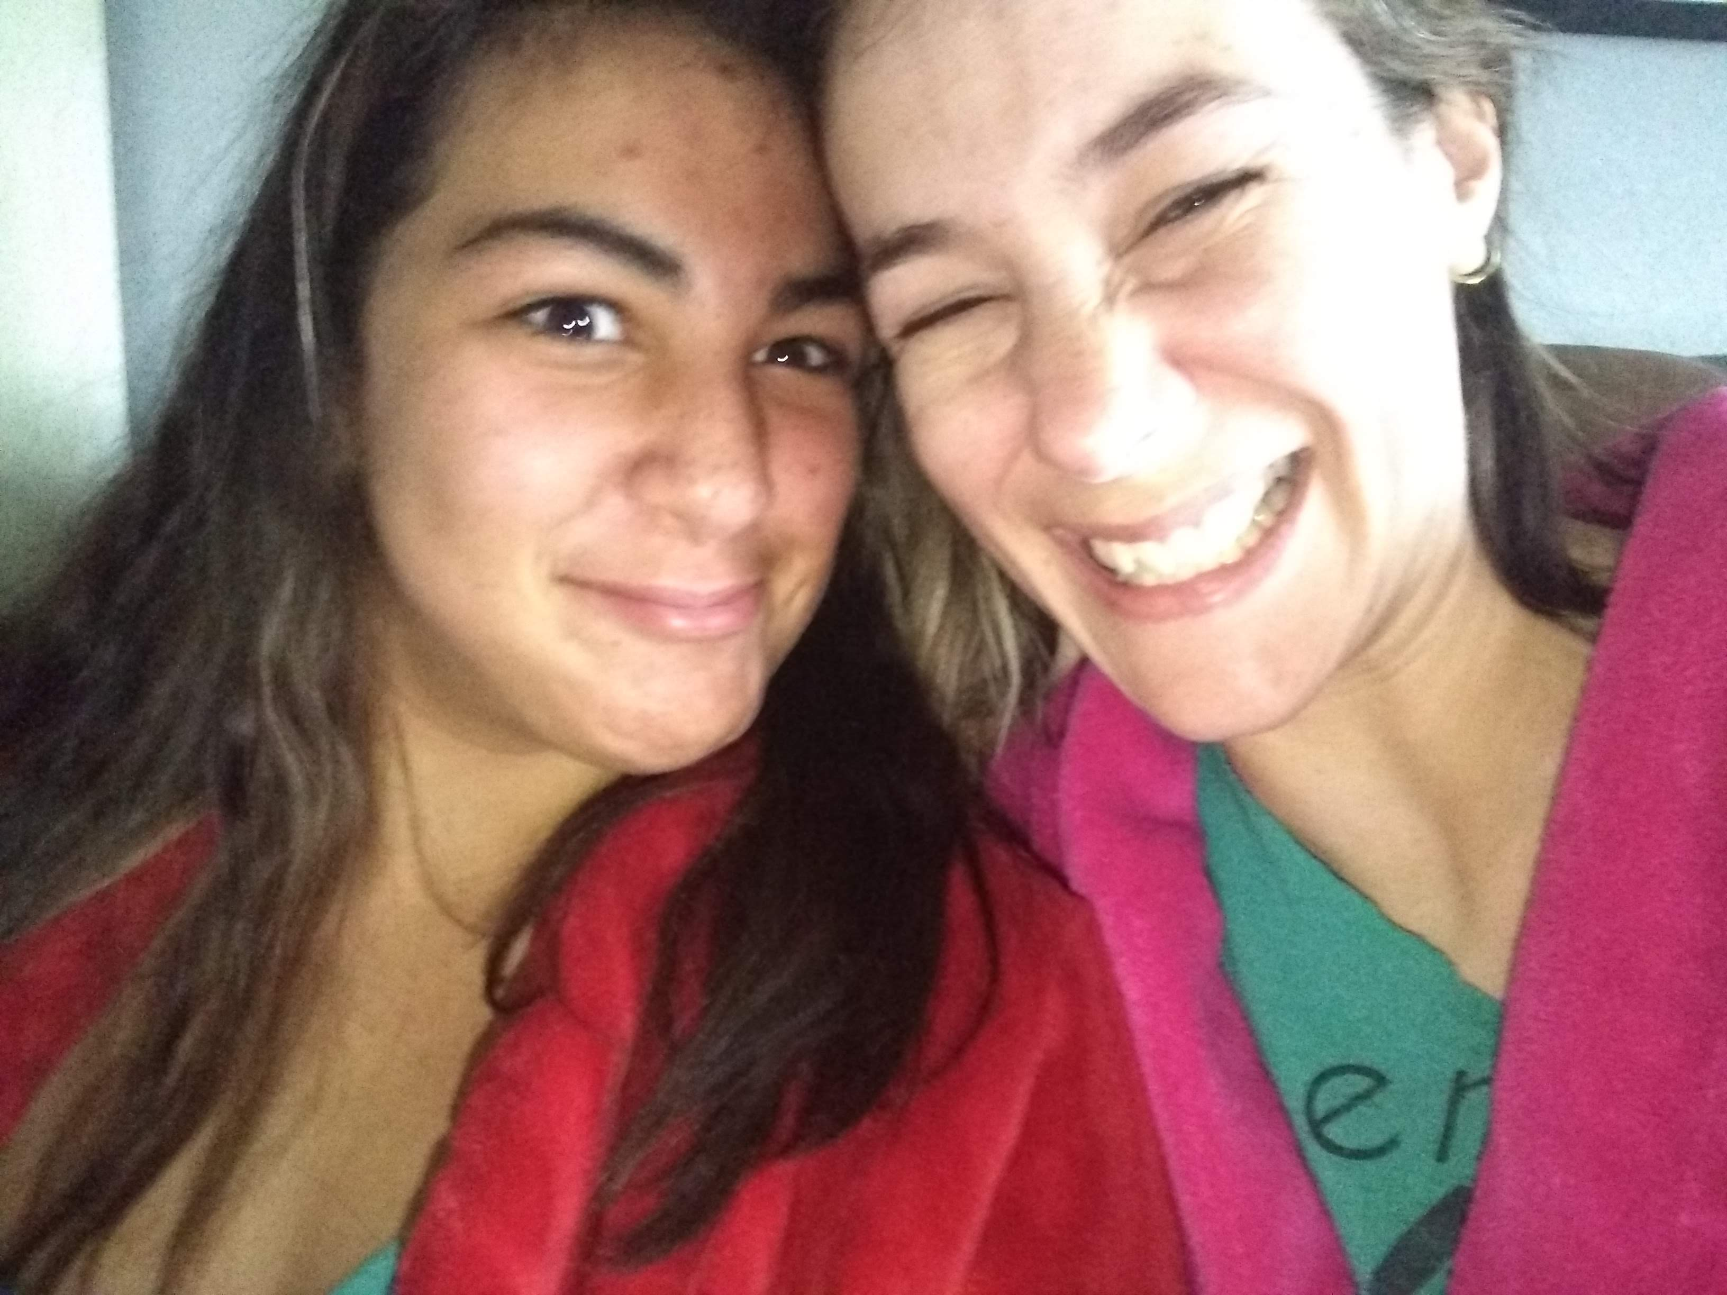
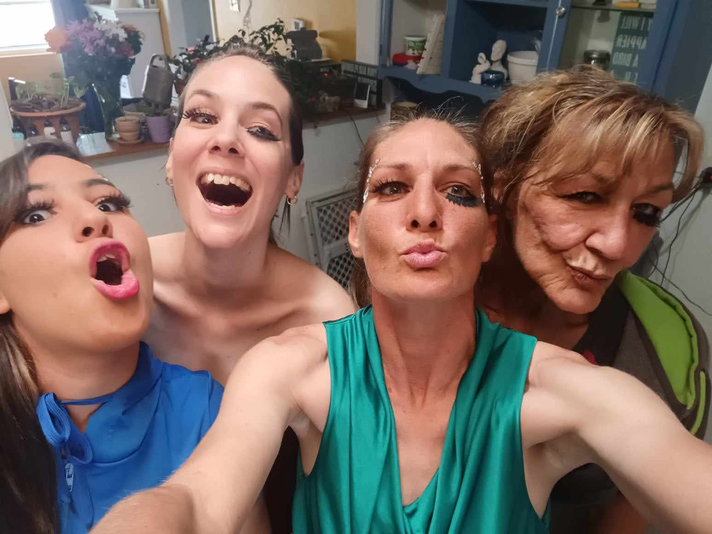
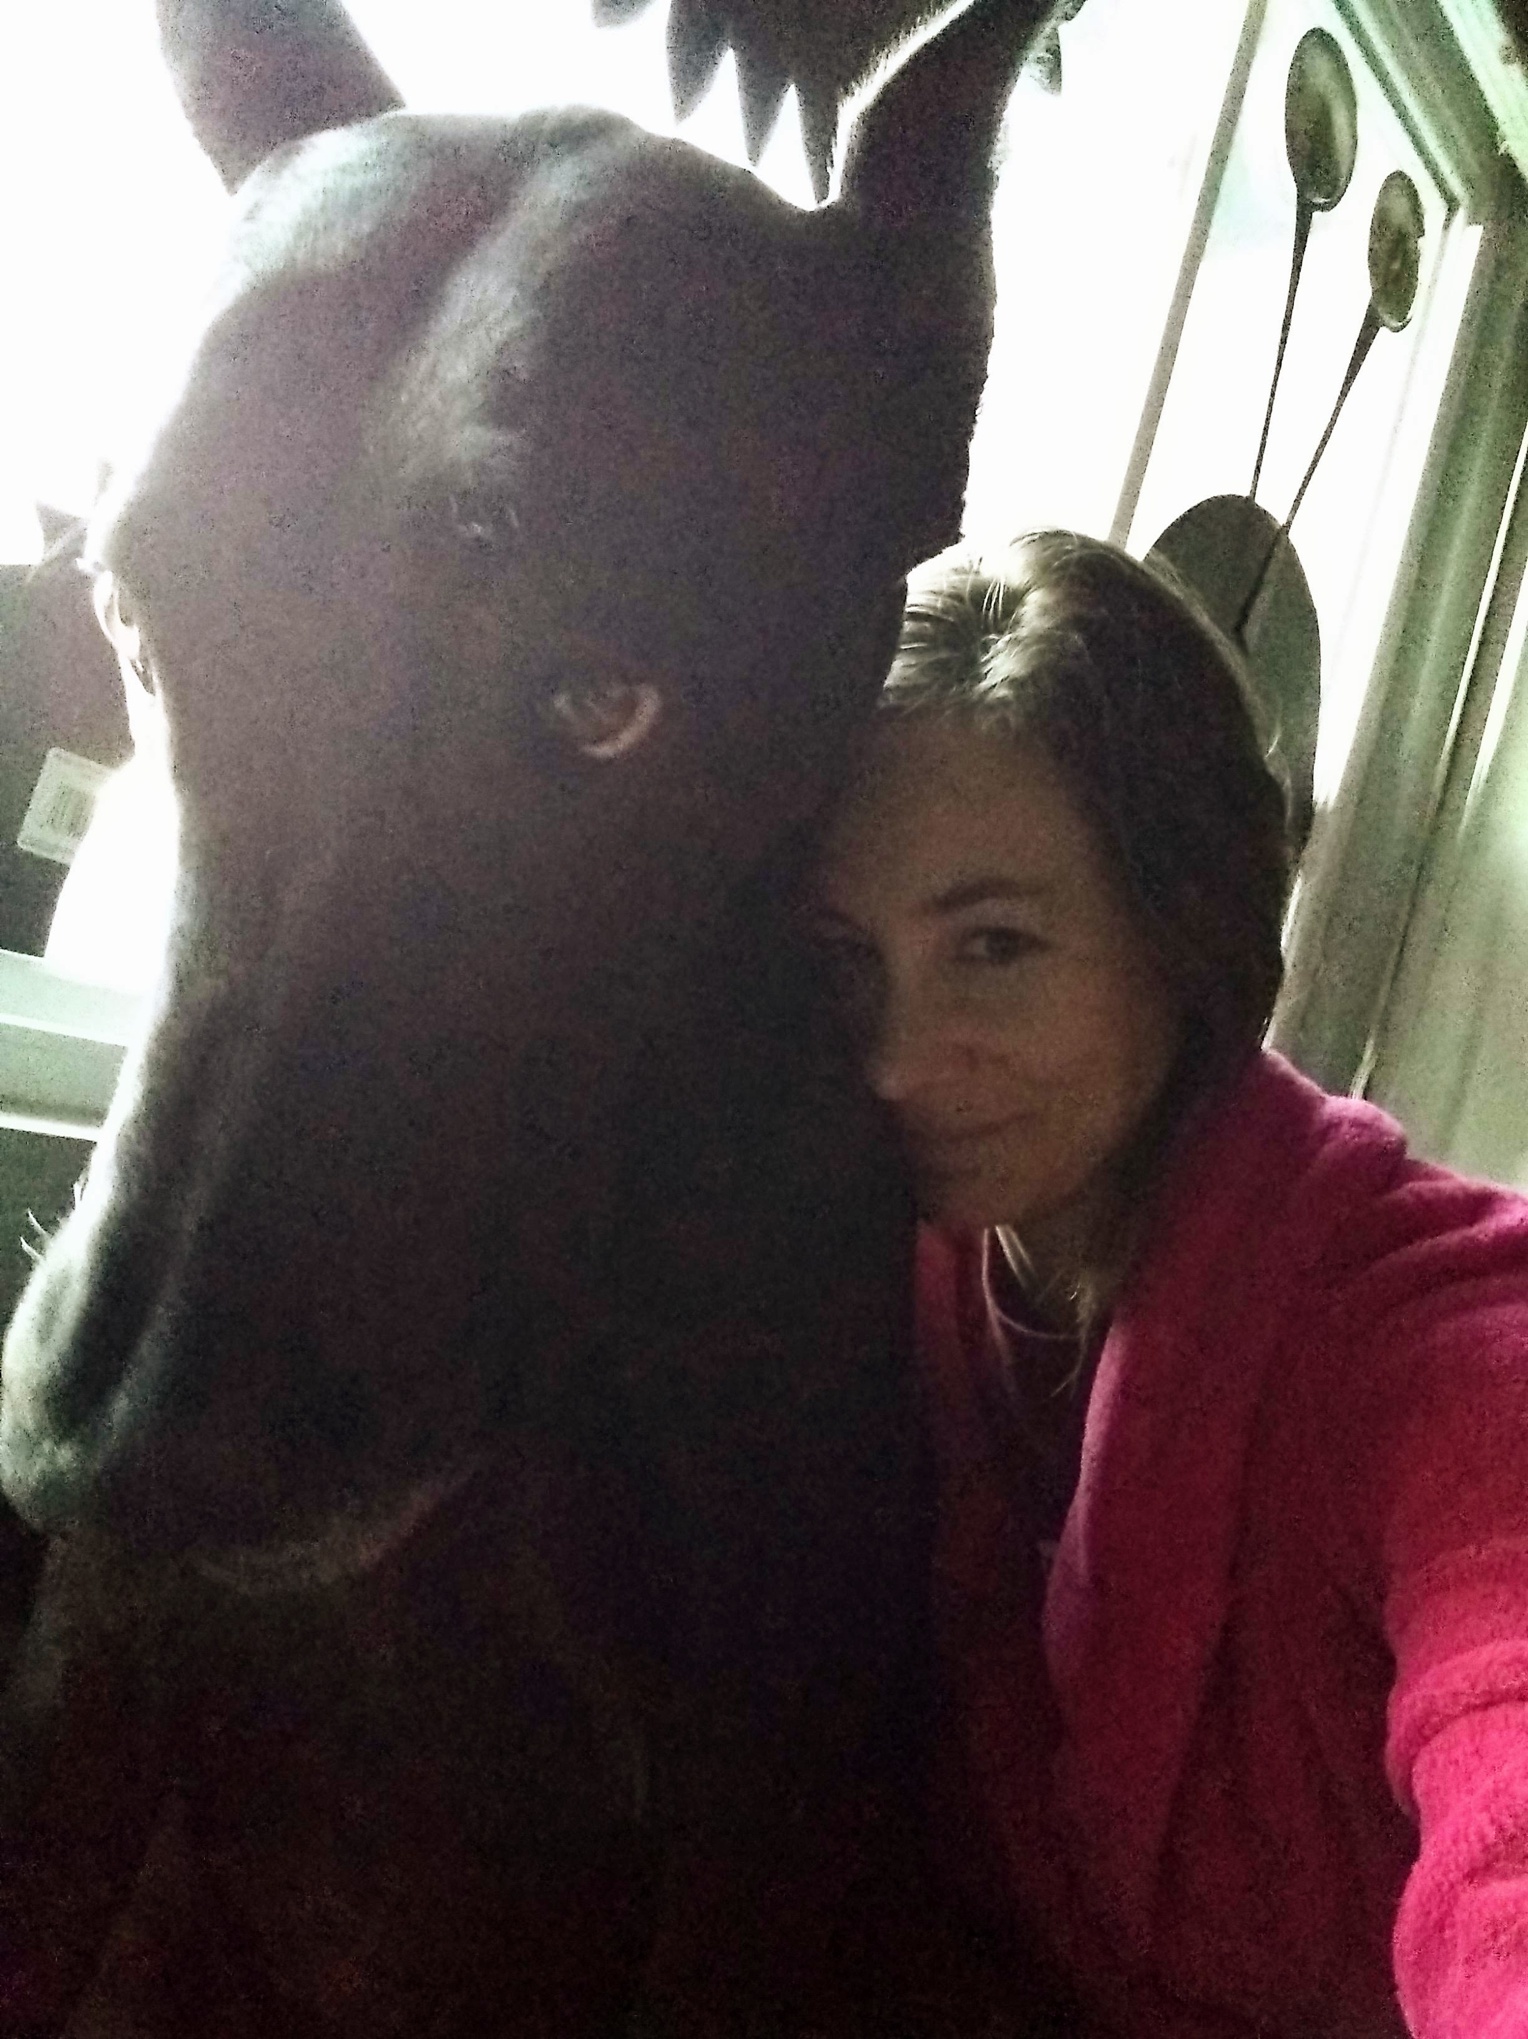
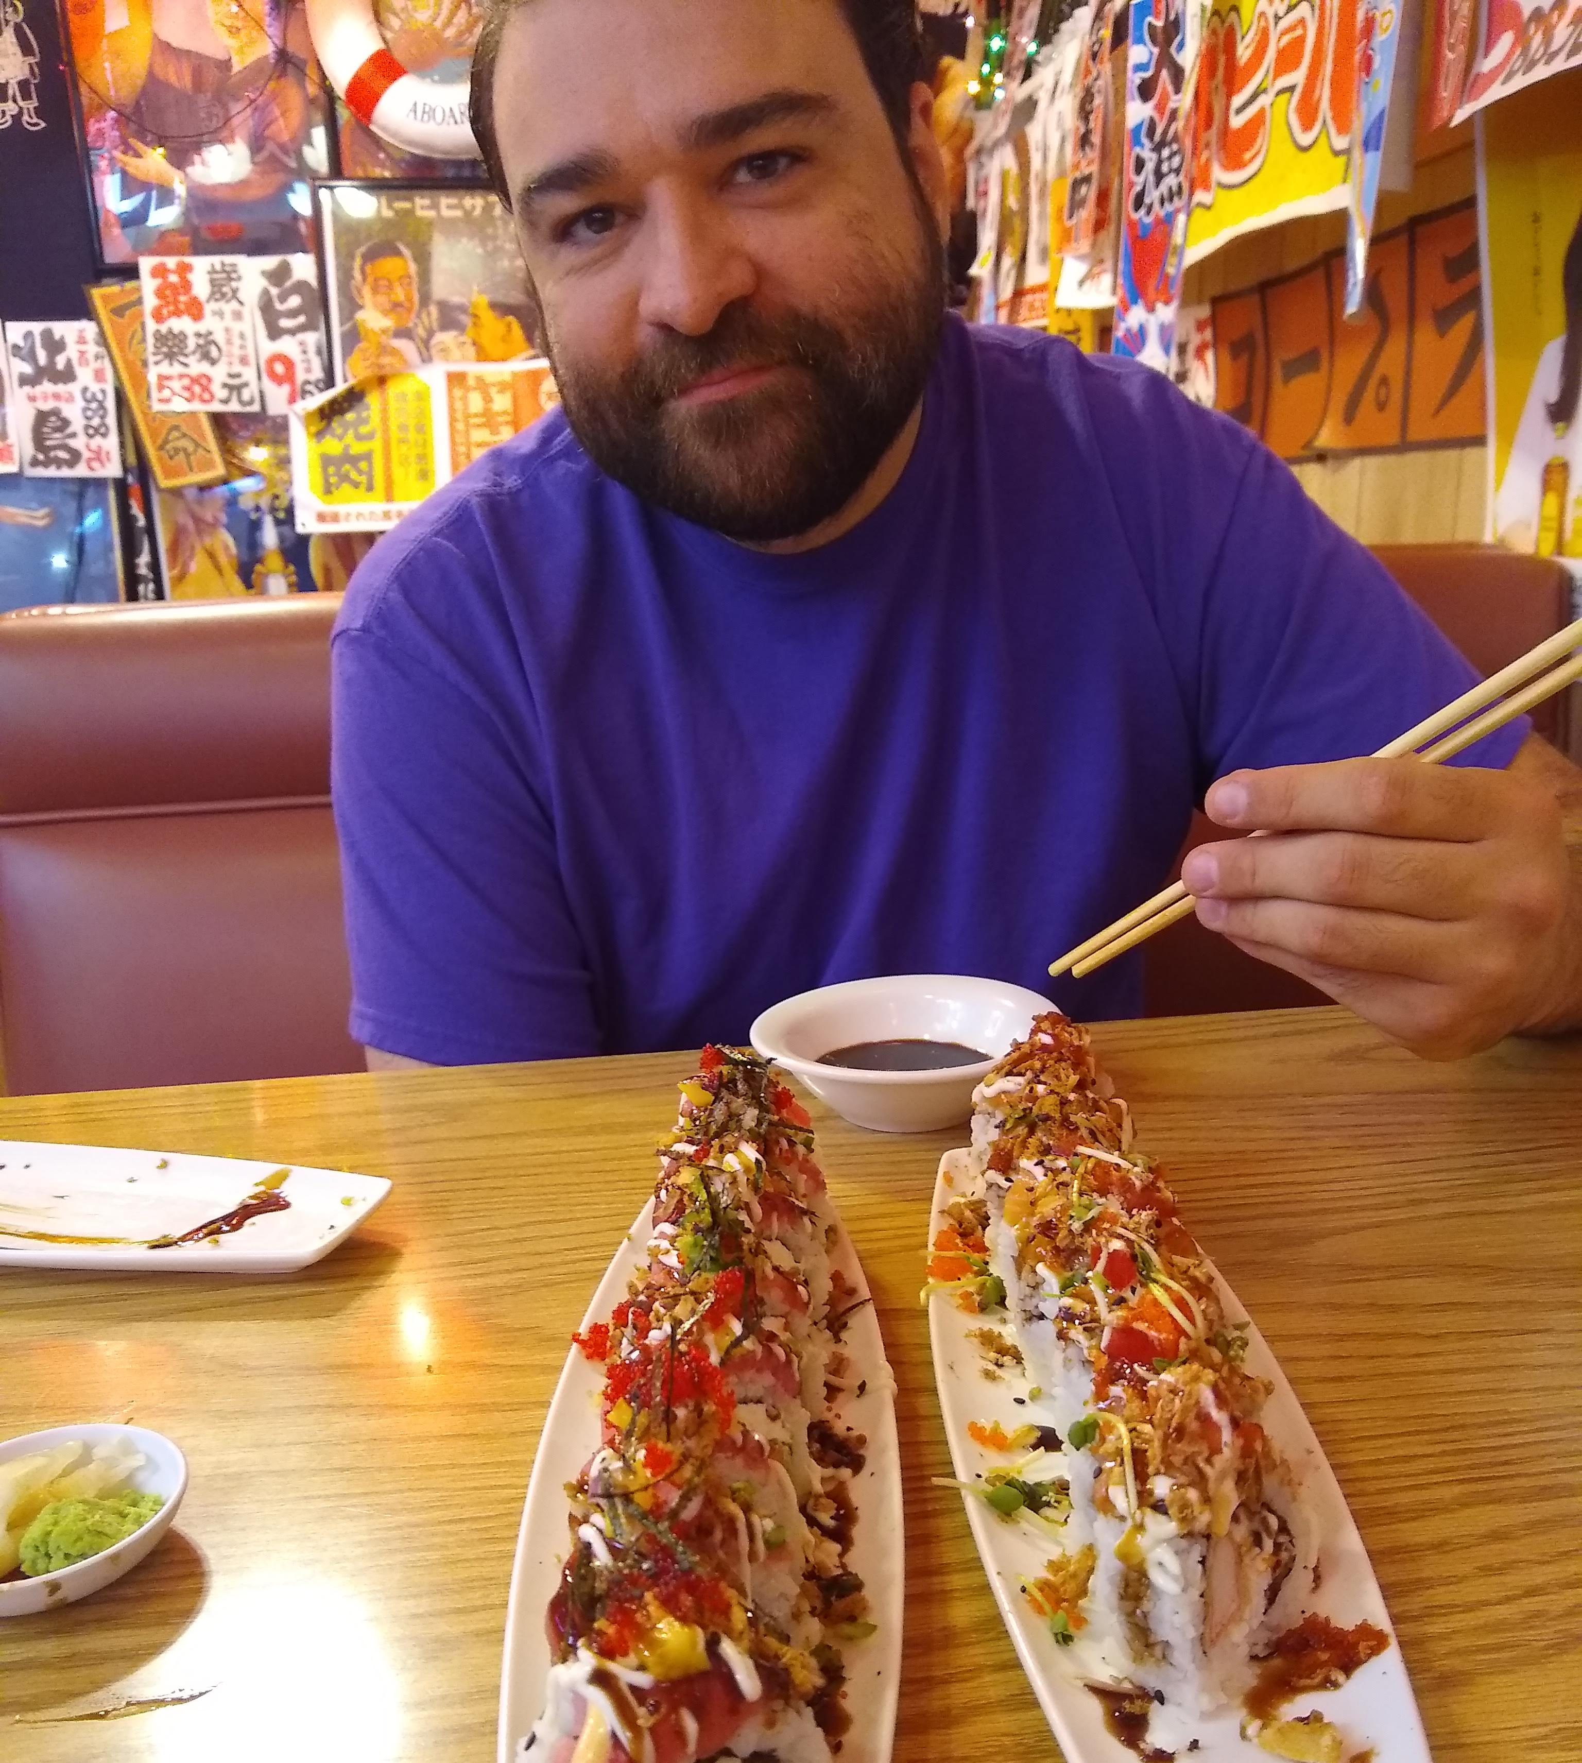
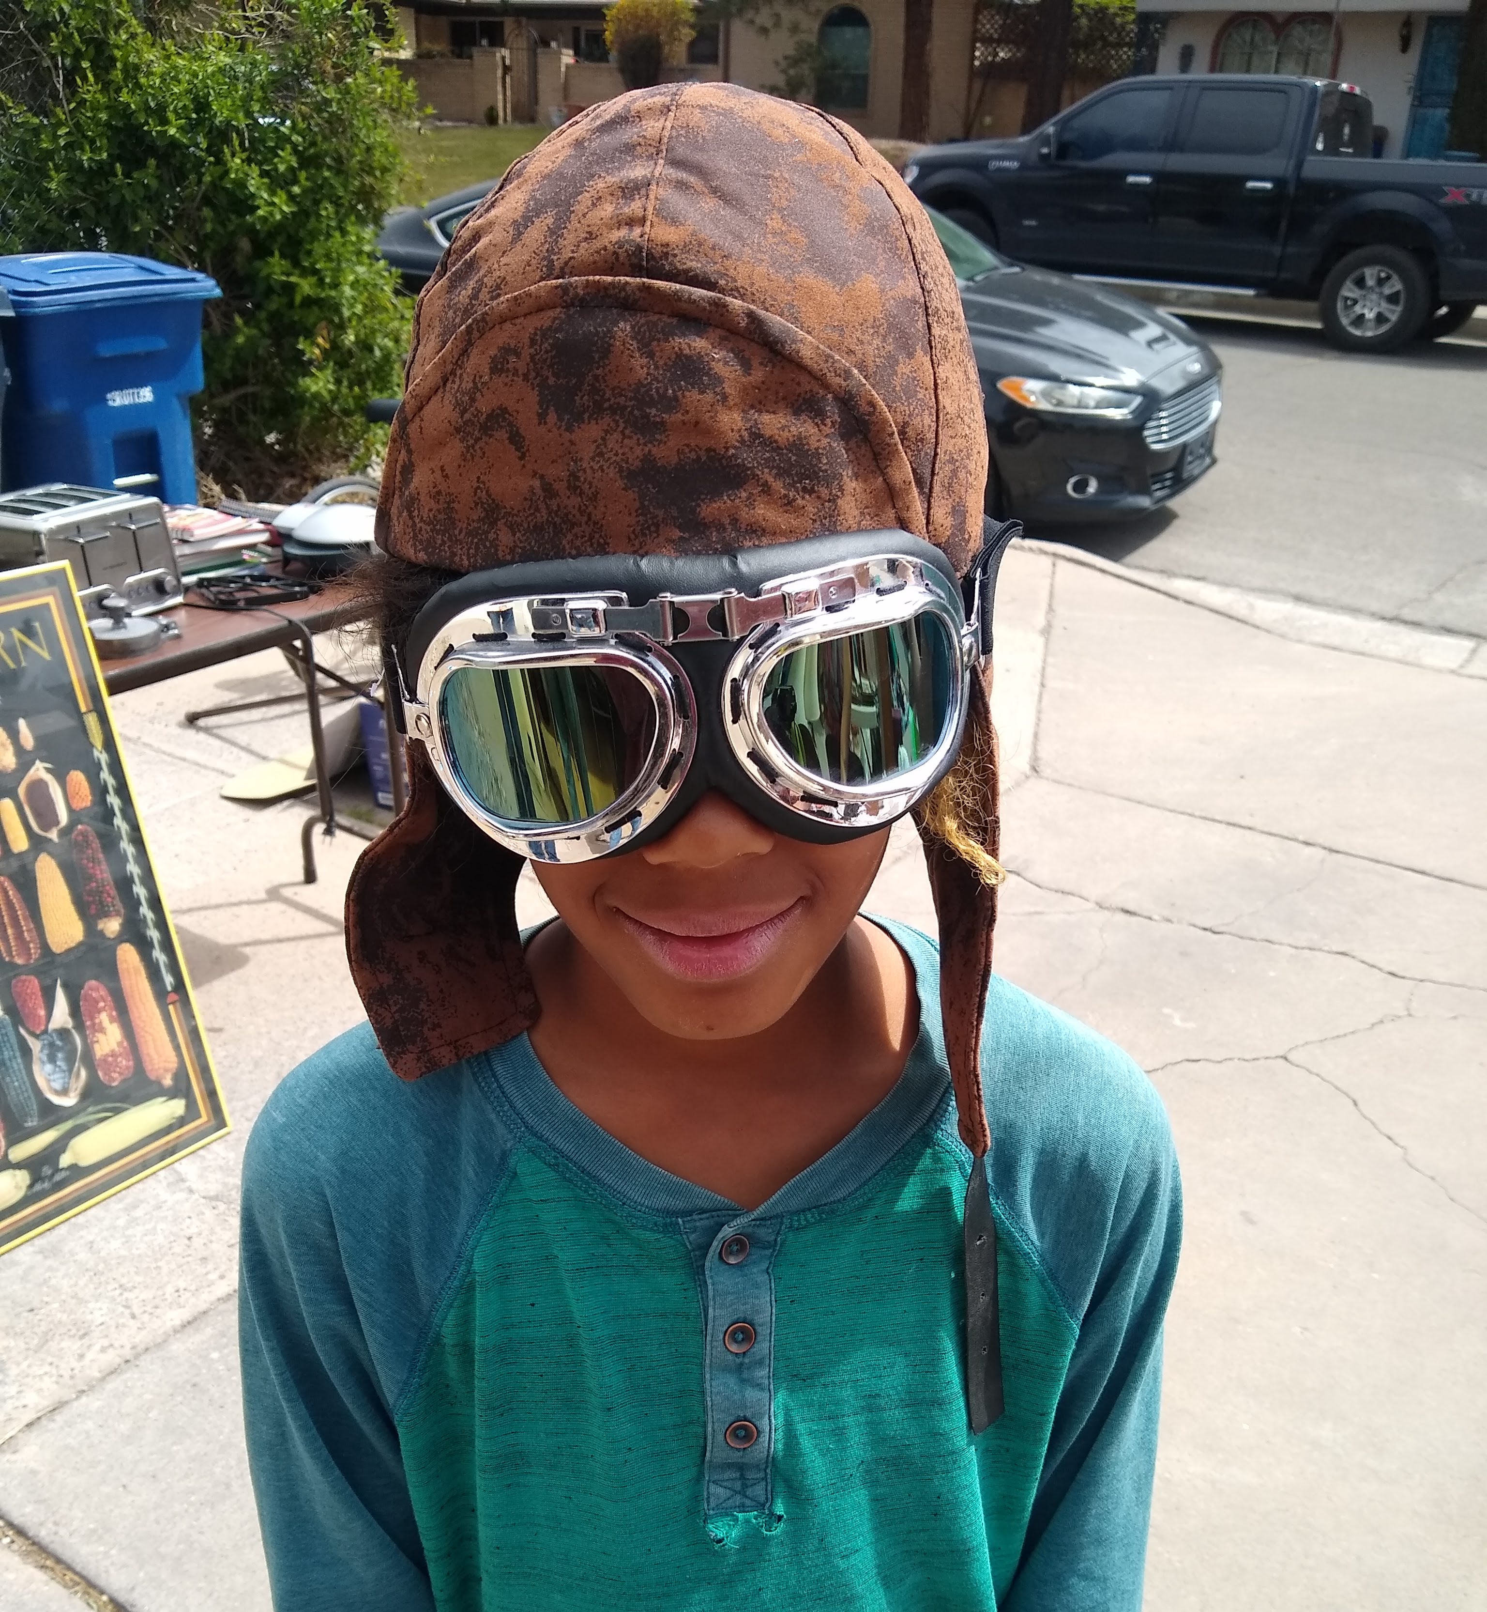
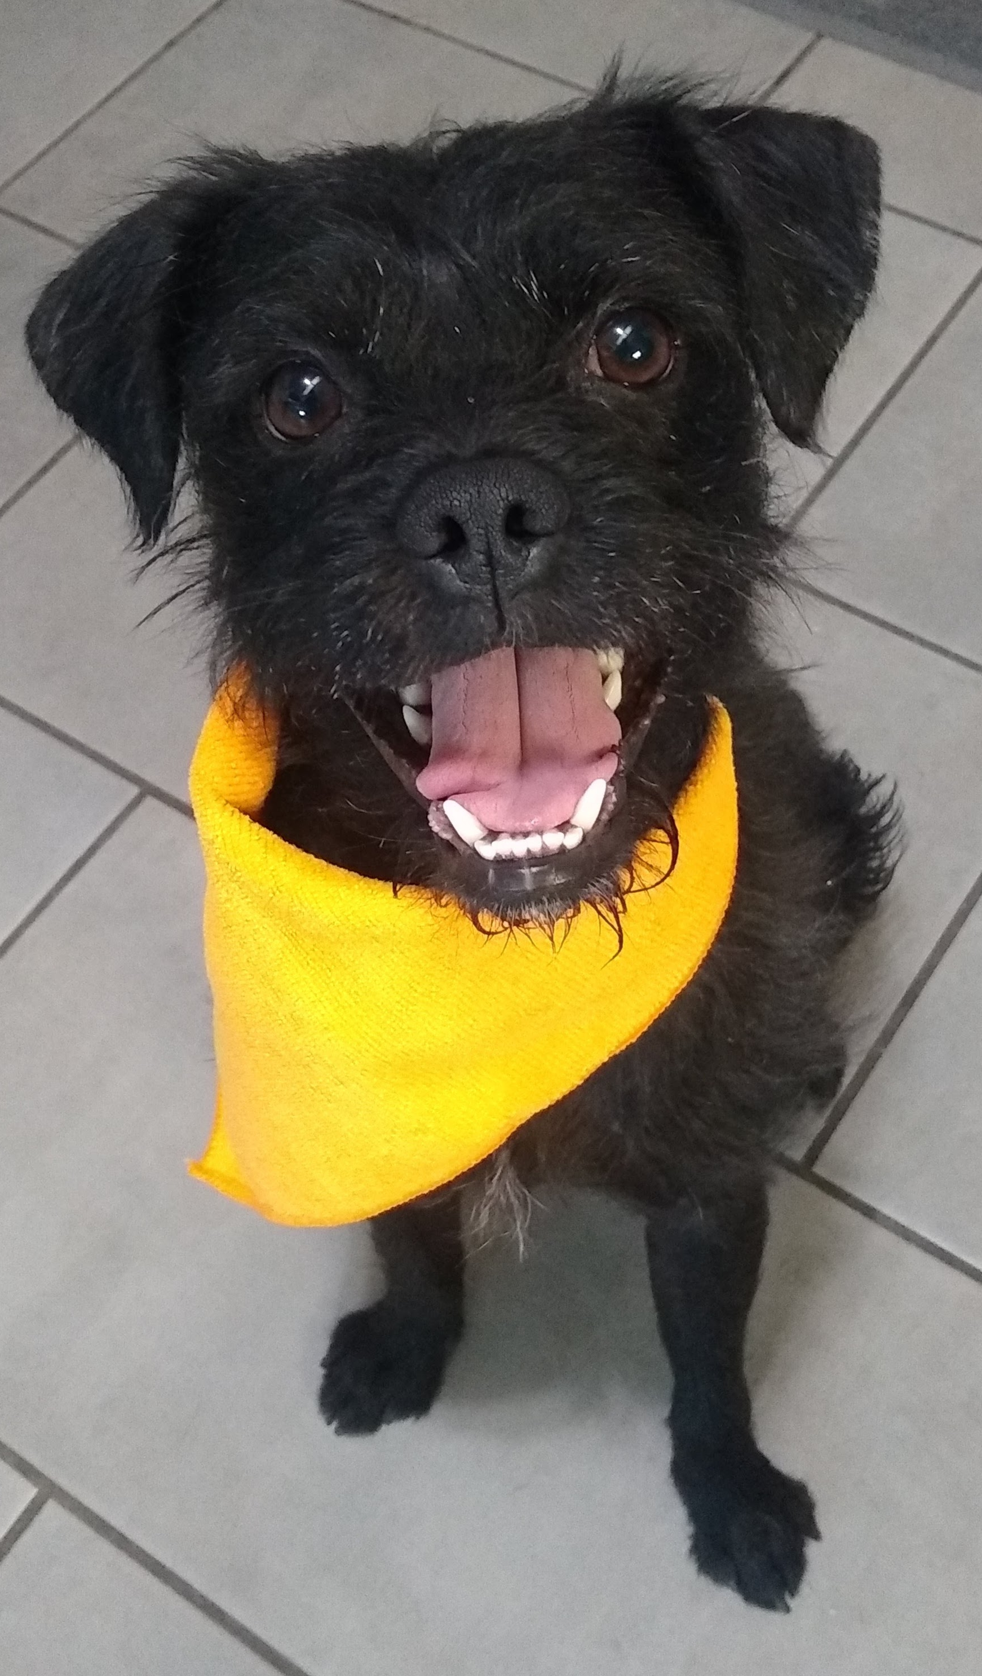

Slide 4
Introductions
Your name is…
Your pronouns are…
Your role in the department…
Tell us something interesting about you.
Why do you work safely?

Slide 5
Change is HERE!
The Safety Program is being rebranded
Notes:
How many of you cringed at being on safety team? Be honest.
We are changing the vibe from icky to fun, from punitive to open, from policies/procedures to connecting with each other, from getting large fines to helping each other stay safe, from quietly hurting yourself to fearlessly discussing problems and solutions.

Slide 6
Notes:
One of the ways we are going to do that is to intentionally be diverse, equitable, and inclusive. We have a very diverse dept so our safety team should represent that to build on the strengths of the unique perspectives of the people in it.
Equity can mean I provide safety trainings in your native language. It’s meeting you where you are. Your voice is so important to me. I take what you say to heart and I noodle on it. Whether its reporting something unsafe, bullying, or having a wild idea – I want to hear it! I’m going to share some of mine today.

Slide 7
Maslow’s Hierarchy of Needs at Work
Notes:
Let’s take a look at the whole spectrum of safety at work.

Slide 8
Notes:
This is the main piece that we are rebranding. This piece has been missing.

Slide 9
How will we accomplish this?
Speak Up
Work Together
Recognition
QR codes to report concerns, issues, ideas anonymously.
I will advocate for you!
We will always take time for your voices during these meetings.
Audit labs
Team atmosphere
Learn from our mistakes and share that experience with others.
Make changes that work.
Stay curious and open-minded.
How do you like being appreciated?
What makes you feel valued?

Slide 10
Some of my ideas
Engaging safety videos with multiple language captions.
QR codes on instruments, linked to SOP and video.
Stretch/Movement Program
Green chemistry
Video interviews of accidents to share with team and learn.
Lab audits together to learn best practices.
Recognition for good safety performance.
Feminine products in the restrooms.

Slide 11
What are your ideas?

Slide 12
Safety Lead Role
Liaison
Safety Audits
Training & Drills
Communicate with your lab/area/team all details of safety team meetings.
Be available to answer questions from your group.
Report new people to me so that I can ensure they receive the proper trainings.
Report good performance so we can recognize it!
Group audits to create transparency and consistency.
Communicate safety changes required to your group.
Follow up.
Teach a training.
Help with videos.
Be our in-house expert.
Assist with annual all-employee drill for fire, intruder, etc.
Lead a movement break.

Slide 13
Schedule Audits by group
Biochemical
Organic
Computational
Teaching
synthesis

Slide 14
Next Steps
Phone numbers for entire group
Update your group about rebranding goals
Audits this summer
SOPs needed
Chemical inventory this summer
Let me know how you can help with trainings
Send me your thoughts!
Please complete as soon as possible and email me updates.

Slide 15
Departmental Updates
Notes:
Helium recovery, faculty changes…

Slide 16
Next Meetings – Poll
September
November

