Slide 1
Safety Team Meeting
December 2023

Slide 2
Agenda
Lab Hazard Assessment Tool
Freezer Inventory
Pipette/Balance Calibration
Super Secret Emergency Drill

Slide 3
Laboratory Hazard Assessment Tool
Please complete before Spring semester.

Slide 4
Freezer Inventory
Please complete before Spring semester.

Slide 5
Pipette/Balance Calibration
Happening today through Wednesday.

Slide 6
Super Secret isn’t Super Safe
While a surprise alarm might inspire haste in evacuating, it creates unnecessary chaos and risks reducing the drill’s effectiveness.

Slide 7
Why are we doing this?
Regular fire drills allow us to practice different roles and responsibilities during an emergency.
Create an actionable plan for future improvements.
Ensure that everyone knows where the emergency exits are located.
Prepares us to consider different evacuation routes.

Slide 8
Buy-in
Leadership agreed on the timing.
Safety leaders should be ready to practice their roles.
Every employee should be aware of the drill and understand its importance.

Slide 9
Communication
Make sure everyone is aware of the plan:
when the drill is taking place
relevant emergency procedures it will practice
detailed instructions for the drill
Send department-wide messages via email
Schedule the drill on employees’ calendars

Slide 10
Fire Drill Goals
Determine the minimum amount of time to:
evacuate and reach the designated assembly area
secure hazardous materials
shut down instrumentation that could exacerbate an emergency
Measure employee understanding and confidence—if someone’s running around confused during a drill, they’re a risk to both themselves and others
Add specific procedures based on our needs.

Slide 11
Specifics to Add
instructions for turning off machinery or equipment
Will any employees remain on site during an initial alarm? For example, to shut off equipment that poses a fire hazard risk before evacuating.
Will any employees be responsible for rescue or medical care? Who are these workers, and what medical duties will they have?
Will employees use a communications program to mark themselves safe during an emergency?

Slide 12
Collect and Analyze Results
Collaborate on an after-action report that covers the critical points of the safety drill and how it went.
Refine our plans, run more drills in the future, and determine whether we’re measurably improving.
Everyone will participate in the Fire Drill Evaluation (if they participate)
Safety Team will be sent a link to a separate evaluation form.

Slide 13
Tabletop Exercise
Coordinated discussion for you to review your roles during a fire emergency and how you might react in various scenarios.
Take team members through the evacuation routes and various contingency plans so they are prepared for the unexpected.
To familiarize you with your roles and responsibilities, we are going to do a walkthrough.

Slide 14
Fire Drill Roles

Slide 15
Fire Warden (Bobby)
Alert the fire department about‌:
The fire’s location.
The severity of the fire.
If there anyone that needs additional help.
Which building exits were used.
If there are any impassable or unusable exits.

Slide 16
Timekeeper (Kali)
To achieve our goal of determining how long it takes for us to evacuate and know that the entire building is clear.

Slide 17
Videographer (Cat)
Videos will help make this training available online going forward.

Slide 18
Pull Fire Alarm (Jeremy)
I wonder how longed he has dreamed of this.

Slide 19
Evacuation Location (Eunice)
Grab the Go Kit
Lead everyone to the Rose Garden
Check in with Safety Team as they finish their sweeps, ensuring everyone is accounted for
Wave Red/Green flag
Move locations if needed (smoke, fire, weather)
Assign new roles based on need (someone to watch for evacuees if need to move to new location)

Slide 20
Riebsomer 3rd Floor (Xuechen)
Final sweep of 3rd floor rooms, labs, shared spaces, stairwells
Report to Eunice

Slide 21
Riebsomer 2nd Floor (Jing)
Final sweep of 2nd floor rooms, labs, shared spaces, stairwells
Report to Eunice

Slide 22
Riebsomer 1st Floor (Alex)
Final sweep of 1st floor rooms, labs, shared spaces, stairwells
Report to Eunice

Slide 23
Riebsomer Basement (Curt & Bing)
Final sweep of Basement floor rooms, labs, shared spaces, stairwells
Report to Eunice

Slide 24
Clark 2nd Floor (Dr. Rack)
Final sweep of 2nd floor offices, breakroom, conference rooms, and bathrooms
Report to Eunice

Slide 25
Clark 1st Floor (Gary)
Gather lab technicians
Secure labs
Final sweep of 1st floor offices, breakroom, labs, and bathrooms
Report to Eunice

Slide 26
Clark Basement (Dave)
Final sweep of Basement floor offices, labs, conference room, and bathrooms
Report to Eunice

Slide 27
Individual (everyone)
Make your space safe (shut off …)
Grab your coat
Tell your friends
Pull the door shut on your way out
Evacuate to Rose Garden
Wait for “All Clear”

Slide 28
Roles
Fire Warden – Bobby
Timekeeper – Kali
Record video – Cat
Pull fire alarm – Jeremy Edwards
Eunice – Lead out to Rose Garden with Go Kit
Individuals – Coat, shut doors, evacuate
Riebsomer: Final Sweep
3rd Floor – Xuechen
2nd Floor – Jing
1st floor – Alex
Basement – Curt & Bing
Clark: Final Sweep
2nd Floor – Jeff
1st floor – Gary
Basement – Dave

Slide 29
Fire
Our buildings are equipped with fire detection and suppression systems.
We are also close to Albuquerque Fire Station 3; response time is normally 5 minutes or less.

Slide 30
Fire: What to Do
Alert all people in immediate area
Pull fire alarm
Call 911
Close all doors to help contain fire and smoke
Next Step: Extinguish or Evacuate

Slide 31
Fire: Extinguish
If the fire is small and you have been trained to use a fire extinguisher use the PASS Acronym:
Pull the Pin
Aim at the base of the fire
Squeeze the handle
Sweep side to side

Slide 32
Fire: Evacuate
If the Fire Alarm sounds, calmly leave the building via the closest exit.
If smoke is encountered, stay close to floor where air is cooler and smoke free.
Before opening solid door, feel with the back of your hand. If door is cool, open slowly. If door is hot or smoke is detected on the other side, do not open. Find another way out.
If you are unable to exit, seek shelter in a safe place, call 911, and yell for help.
As you are exiting the building, check the restrooms or classrooms along your route to ensure that everyone is told to evacuate (especially individuals who may not have heard the alarm or those who may need additional assistance). If an individual refuses to evacuate, it is not your responsibility to make them leave.
Gather at the designated assembly area:
Rose Garden to the north of SMLC and Clark

Slide 33
Fire: ADA Evacuation
When evacuation is not possible, find the nearest area of refuge (main stairwells) and wait for assistance from emergency personnel.

Slide 34
Fire Alarms (Near stairways)

Slide 35
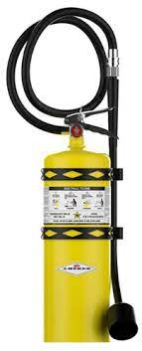
Fire Extinguishers

Slide 36
Exit Routes

Slide 37
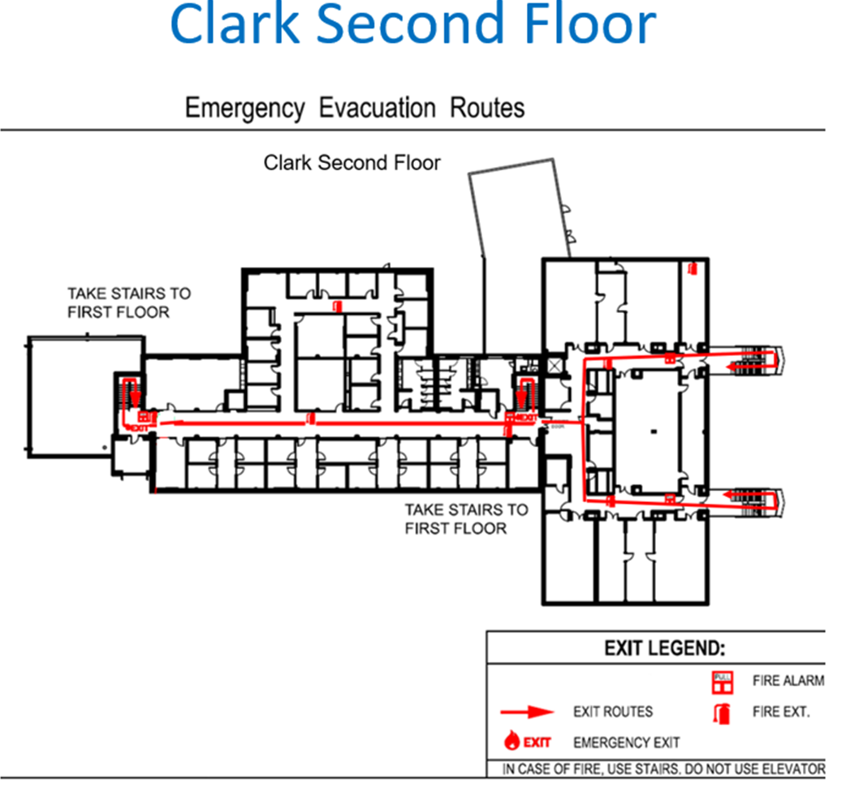
Contingency Plans

Slide 38
Walkthrough
Shut doors
Check rooms on way out
Meet at Rose Garden

Slide 39
Questions

Slide 40
Thank you!
I appreciate all that you are doing for our department.

